Slide 1
CS 542 Link-State Routing Simulator
Christopher Morcom (Seat 20)

Slide 2
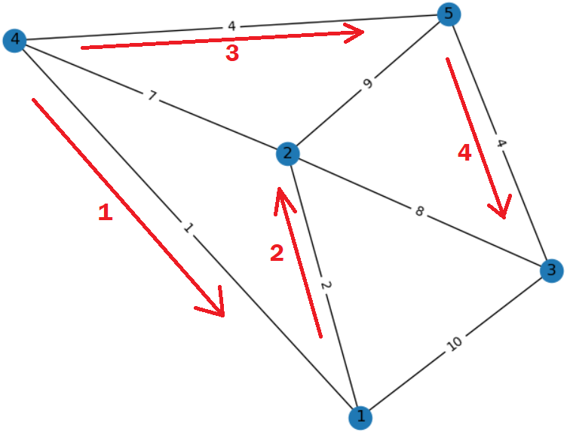
Link-State Routing
Send link-states to all other nodes through flooding
Uses Dijkstra’s Algorithm
Uses higher network traffic
Implements Packet TTL
Implemented in Open-Shortest-Path-First (OSPF) Protocol
Sample flood in project using
router 4 as source for broadcast

Slide 3
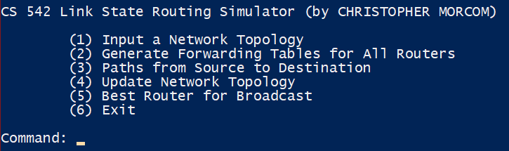
Main Menu
input
output
> Python ./FinalProject.py

Slide 4
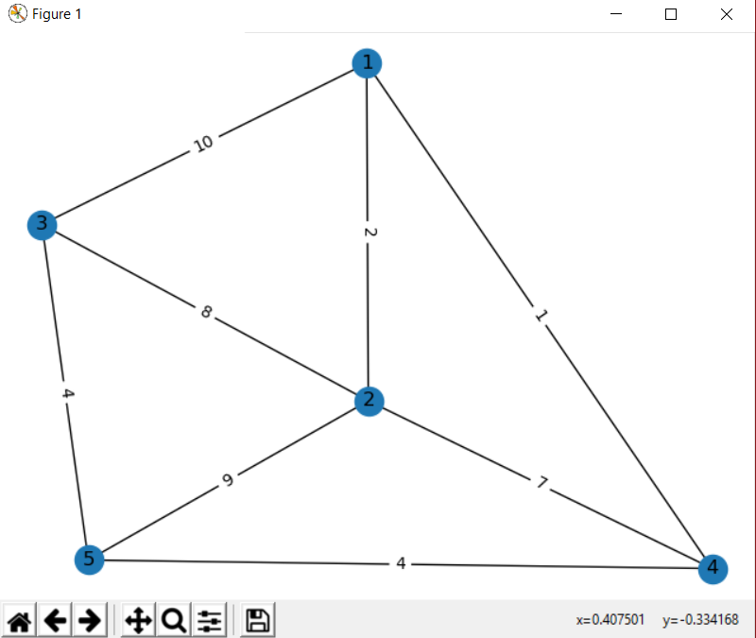
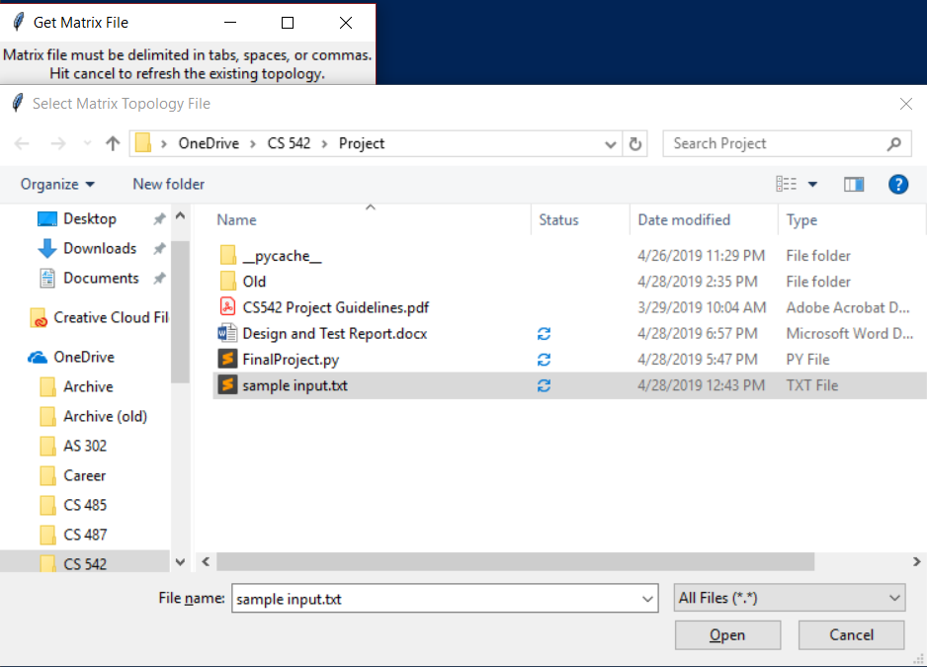
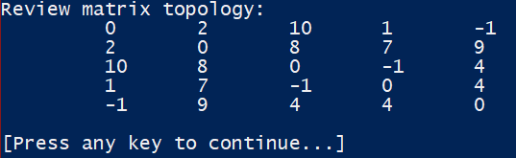
Importing a Matrix
input
output
(From main menu) Command: 1
(Matrix file selected must be readable using whitespace or comma delimiters. No file headers/footers allowed!)

Slide 5
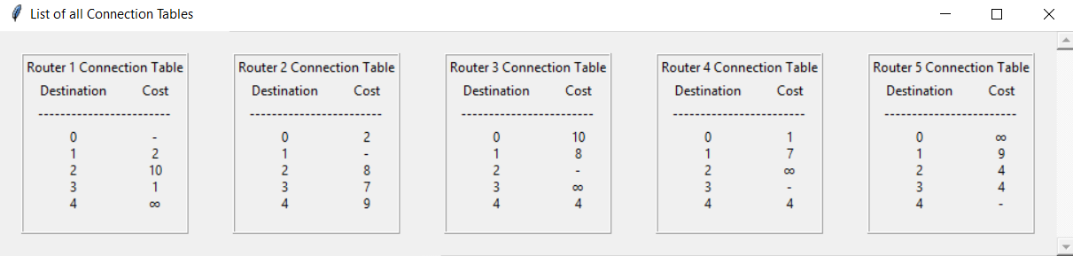
Generating Forwarding Tables
input
(From main menu) Command: 2
(Must be reselected on Network updates!)
output
Window is a scrollable list of all forwarding tables in rows of 5

Slide 6
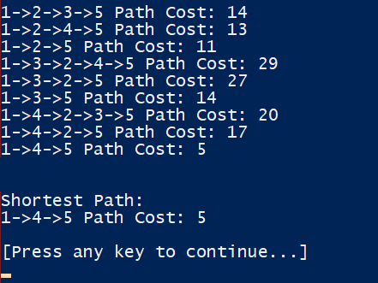
Paths from Source to Destination
input
output
(From main menu) Command: 3

Slide 7
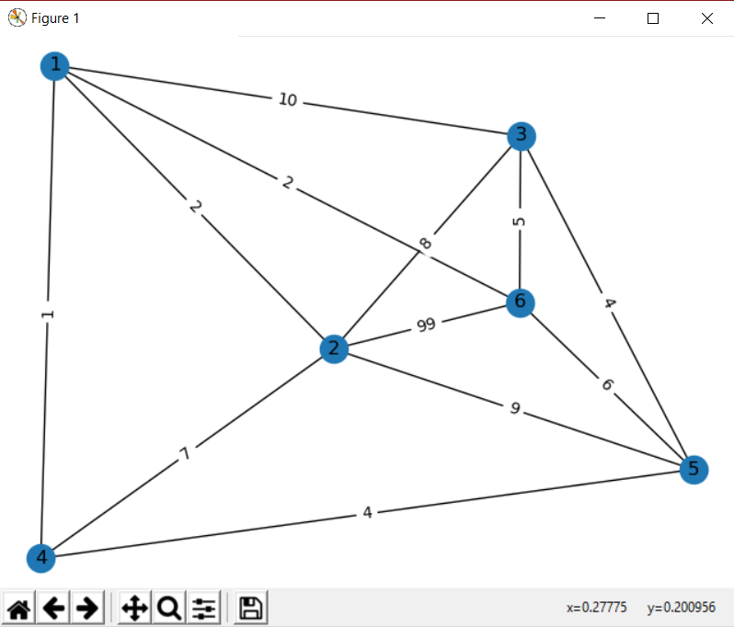
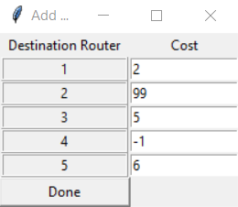
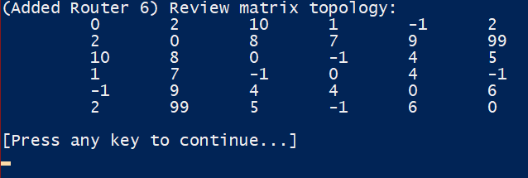
Adding A Node
input
output
(From main menu) Command: 4
(From sub-menu) Option: 1
(User cannot input 0. All negatives are treated as a nonexistent edge)

Slide 8
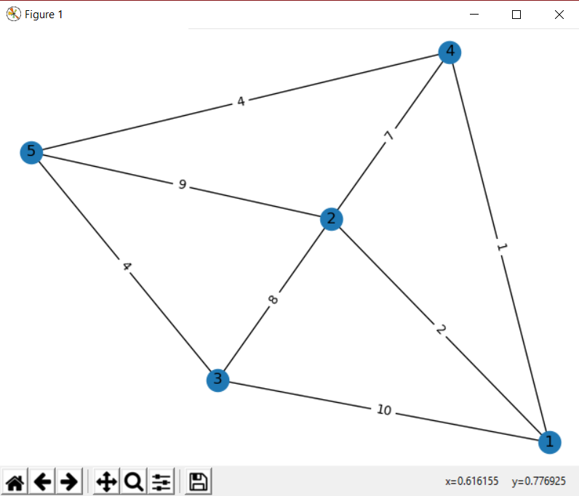
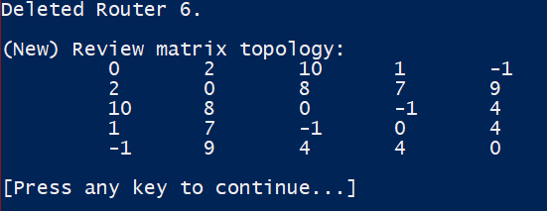
Deleting A Node
input
output
(From main menu) Command: 4
(From sub-menu) Option: 2

Slide 9
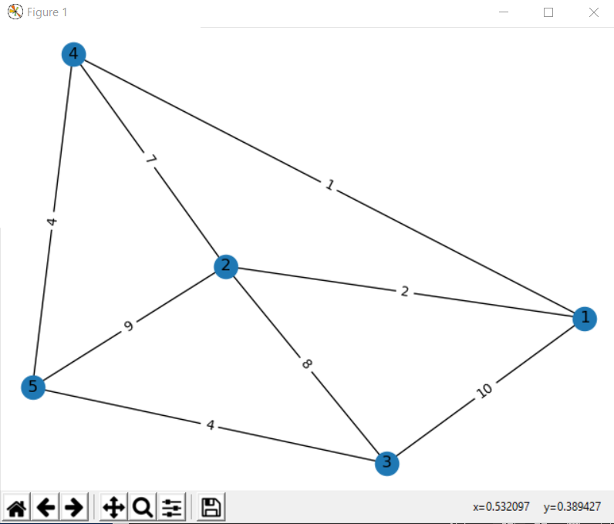
Best Router For Broadcast (Simulate Flood)
input
output
(From main menu) Command: 5
(Refresh Network Topology using option 1 and cancel new input matrix)

Slide 10
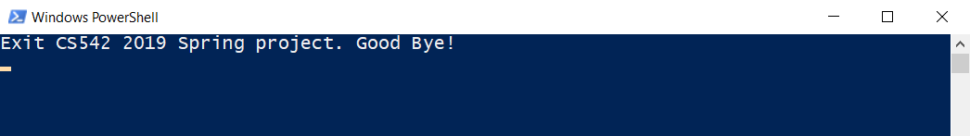
Exiting
input
(From main menu) Command: 6
output

